Slide 1
Lecture 5: Modules 5.1-5.6 Web Client Security CSE 628/628A
Sandeep K. Shukla
Indian Institute of Technology Kanpur

Slide 2
Acknowledgements
Dan Boneh (Stanford University)
John C. Mitchell (Stanford University)
Nicolai Zeldovich (MIT)
Jungmin Park (Virginia Tech)
Patrick Schaumont (Virginia Tech)
C. Edward Chow
Arun Hodigere
Web Resources

Slide 3
Lecture 5: Web Client Security
Total 6 Modules on Web Client Security
Module 5.1: Web Security Landscape
Module 5.2: Web Security Definitions, Goals and Threat Models
Module 5.3: HTTP & Content Rendering
Module 5.4: Browser Isolation
Module 5.5: Security Interface
Module 5.6: Cookies, Frames and Frame Busting

Slide 4
Module 5.1: Web Security Landscape
What are the trends?

Slide 5
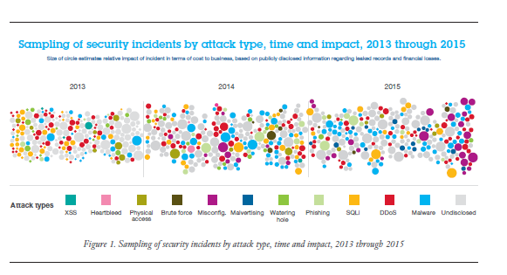

Slide 6
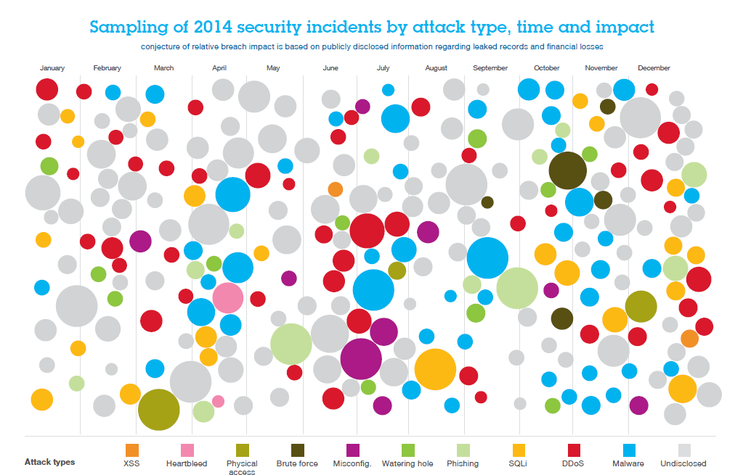

Slide 7
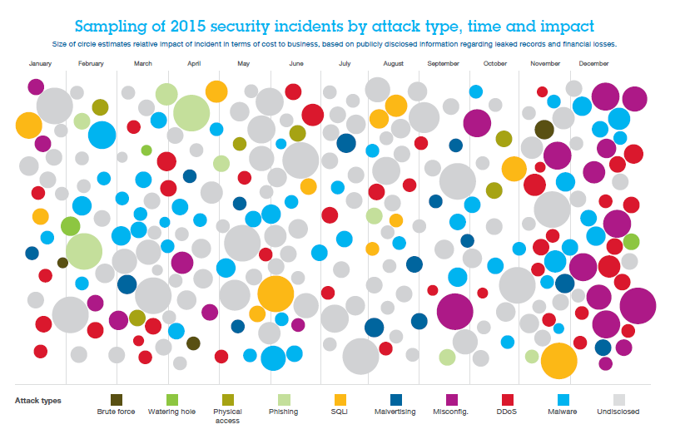

Slide 8
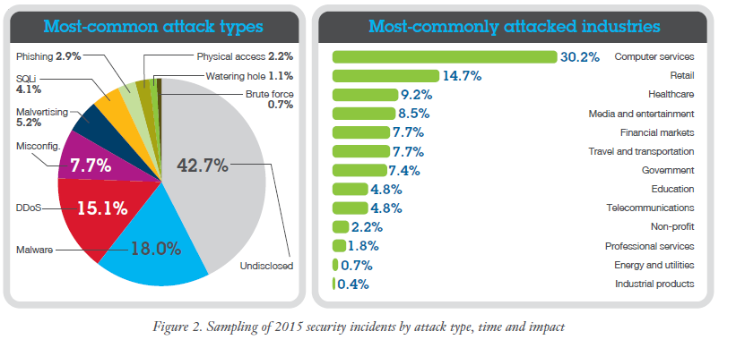

Slide 9
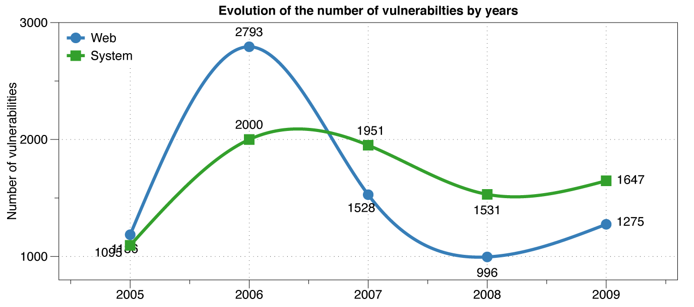
Web vs System vulnerabilities
XSS peak
Decline in % web vulns since 2009
49% in 2010 -> 37% in 2011.
Big decline in SQL Injection vulnerabilities

Slide 10
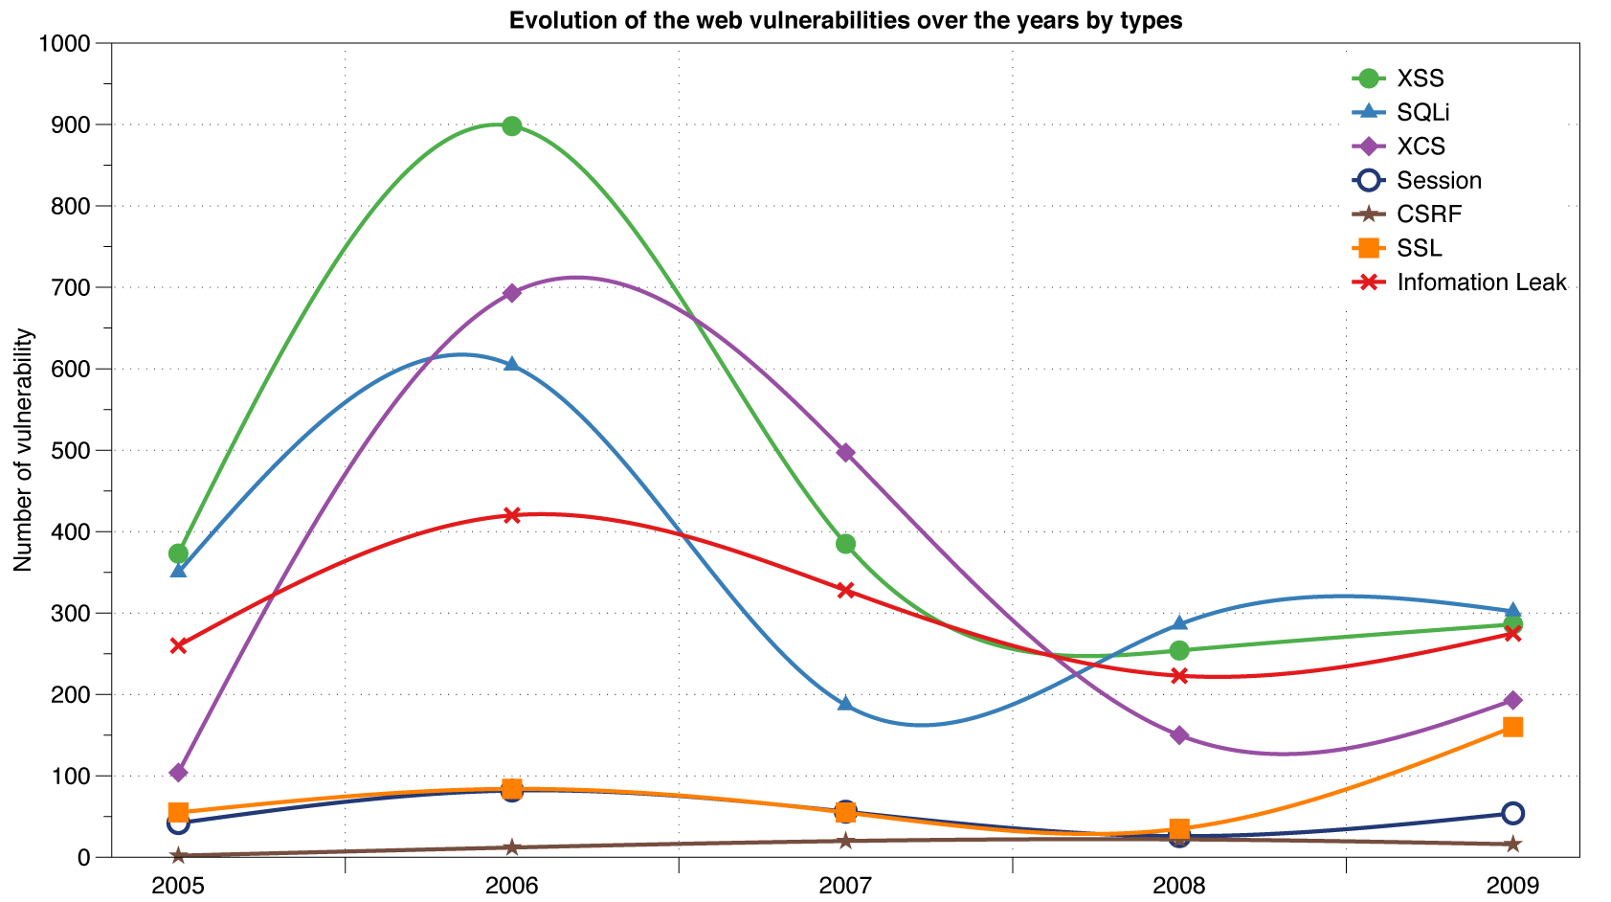
Reported Web Vulnerabilities "In the Wild"
Data from aggregator and validator of NVD-reported vulnerabilities
Notes:
We study the security of embedded web servers used in consumer electronic devices, such as security cameras and photo frames, and for IT infrastructure, such as wireless access points and lights-out management systems. All the devices we examine turn out to be vulnerable to a variety of web attacks, including cross site scripting (XSS) and cross site request forgery (CSRF). In addition, we show that consumer electronics are particularly vulnerable to a nasty form of persistent XSS where a non-web channel such as NFS or SNMP is used to inject a malicious script. This script is later used to attack an unsuspecting user who connects to the device's web server. We refer to web attacks which are mounted through a non-web channel as cross channel script- ing (XCS)

Slide 11
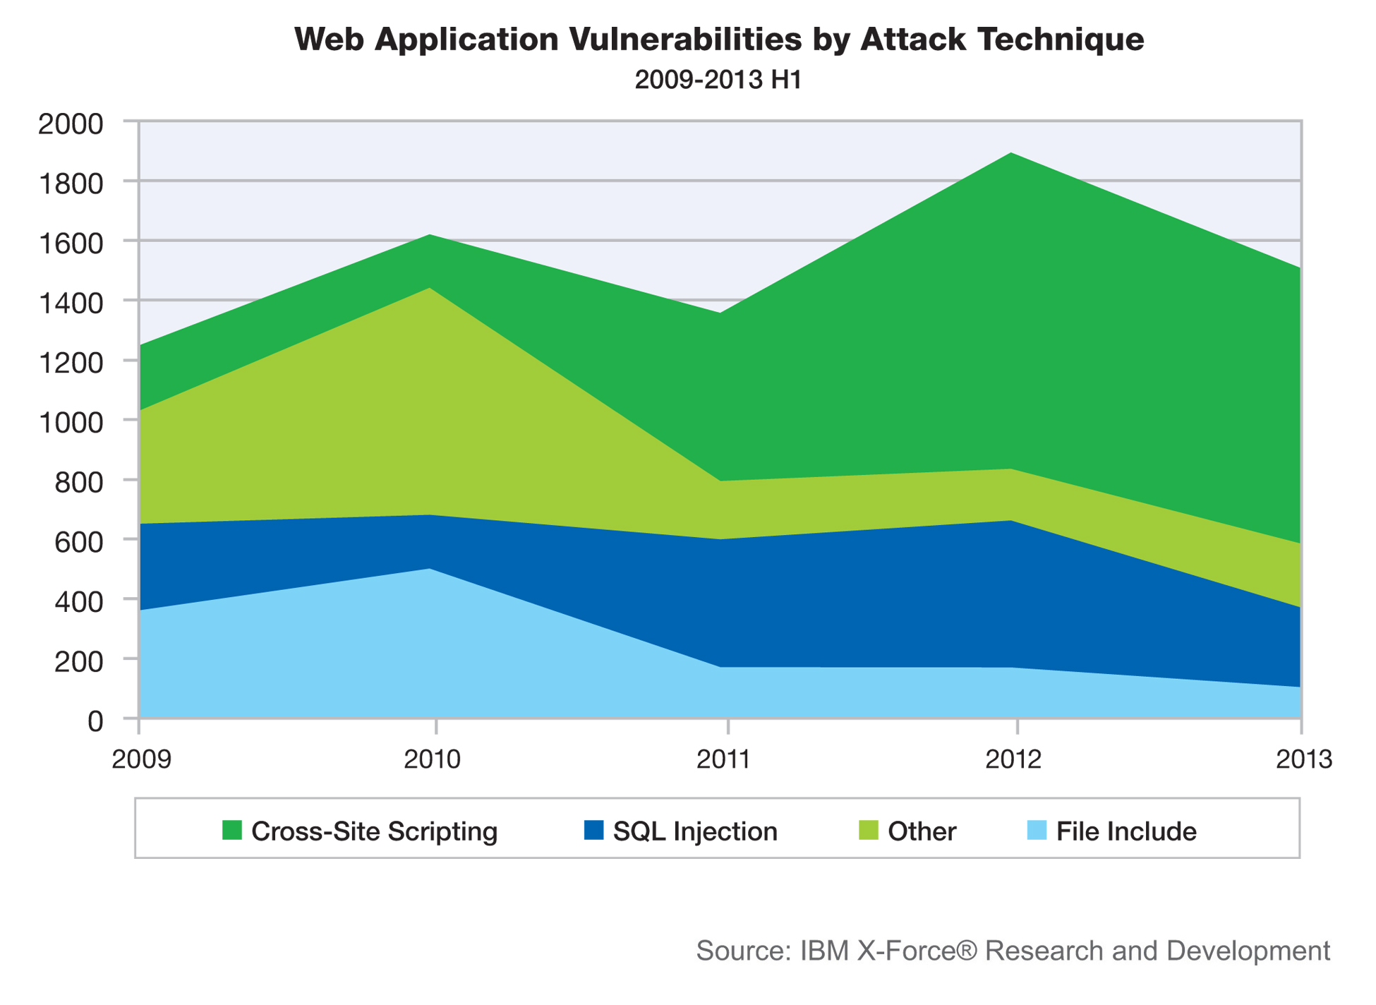

Slide 12
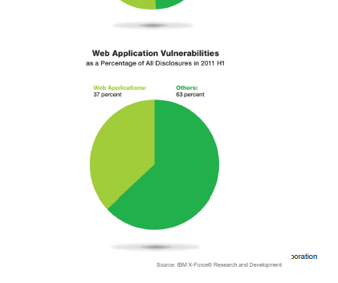
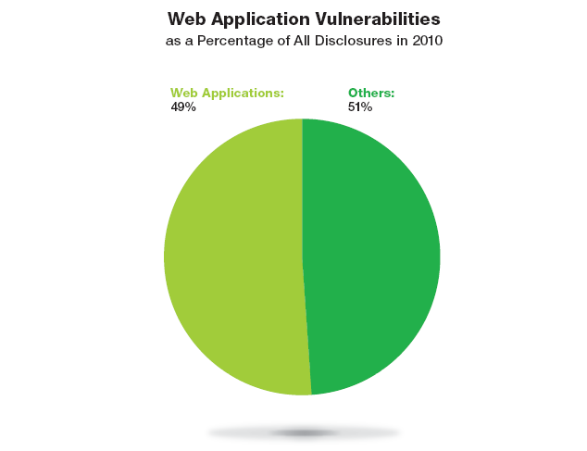
Web application vulnerabilities

